Slide 1
Predicting Bitcoin Prices by using Rolling Window LSTM model
統研所碩一
張泳樺

Slide 2
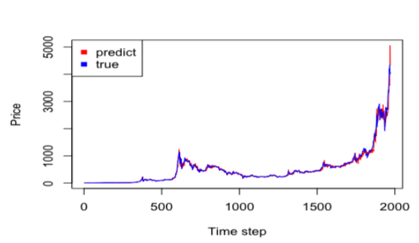


研究背景
USD 5 to USD 4000

Slide 3
文獻回顧
Bootstrap & fixed-size rolling window
Difficulty in building a test set for model selection
Rolling window with regression model & Bayesian neural network
Cannot reflect sequential characteristic in the model

Slide 4
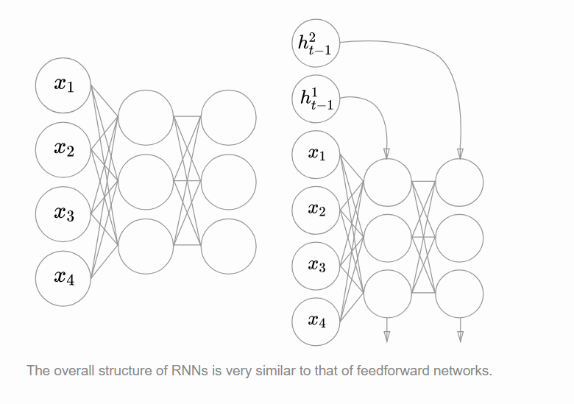
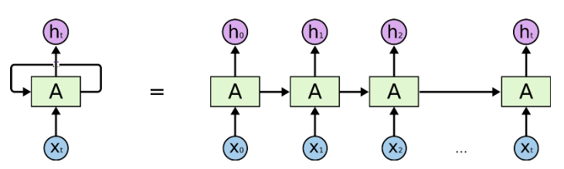
分析方法-RNN
處理時間序列資料
long-term dependencies
gradients vanishing
LSTM

Slide 5
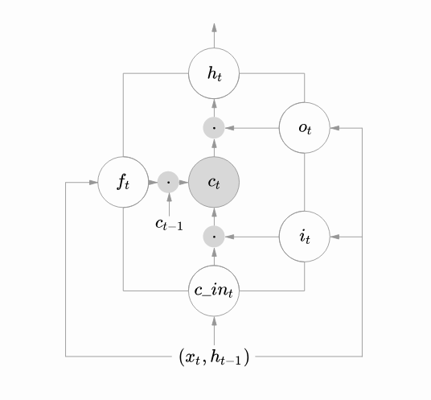
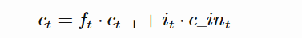








分析方法- LSTM
Gate
input gate
forget gate
output gate
Memory ceil：
$$o_{t}$$
$$o_{t}$$
$$f_{t}$$
$$f_{t}$$
$$C_{t}$$
$$C_{t}$$
$$i_{t}$$
$$i_{t}$$

Slide 6
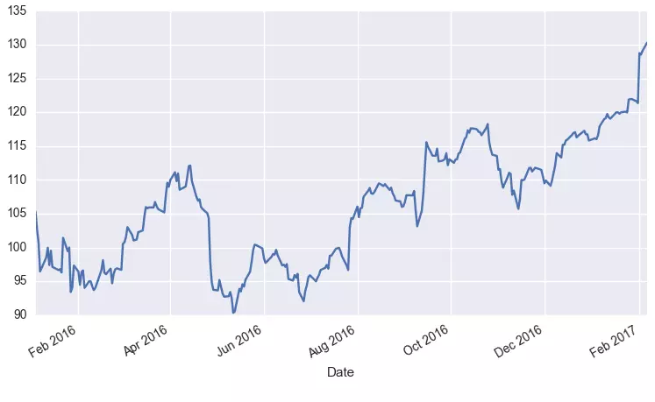

Rolling window
將某個點的取值擴大到包含這個點的一段區間，用區間來進行判斷，此區間即窗口。
如：有100個觀測，用10個觀測
作為一個rolling window 。
$\hat{y^{11}}$=F($x^{1}$, $x^{2}$…. $x^{10}$)
$\hat{y^{12}}$=F($x^{2}$, $x^{3}$…. $x^{11}$)
.
.
.

Slide 7
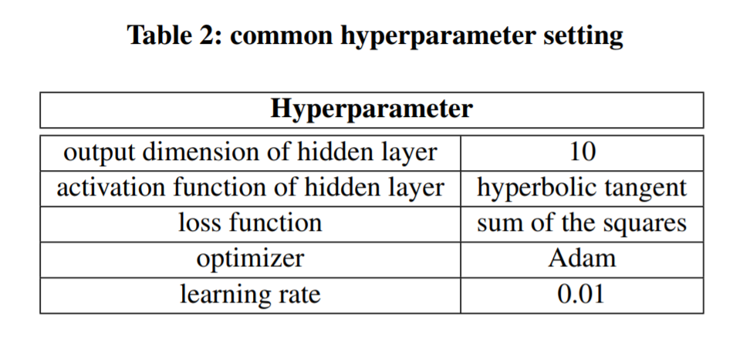
Model setting-(many-to-one)
T = t
Input
17 node
Hidden
10 node
output
1 node

Slide 8
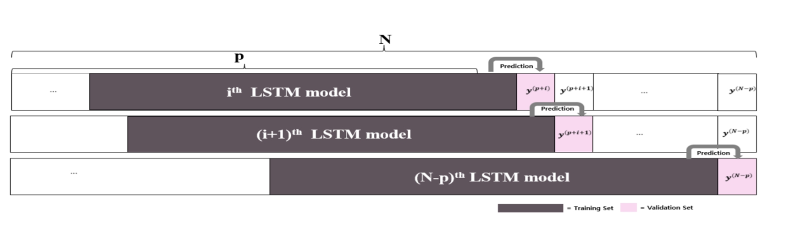
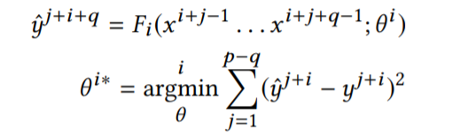

參數介紹
N：# of sample data
P： sequence of time
q：$the i^{th}LSTM^{′}s training length$(time-step)
Hyperparameter tuning

Slide 9
Model
N-p：models that predict N-P time series , these model don’t share weights
Rolling window LSTM model：
Building a model structure

Slide 10
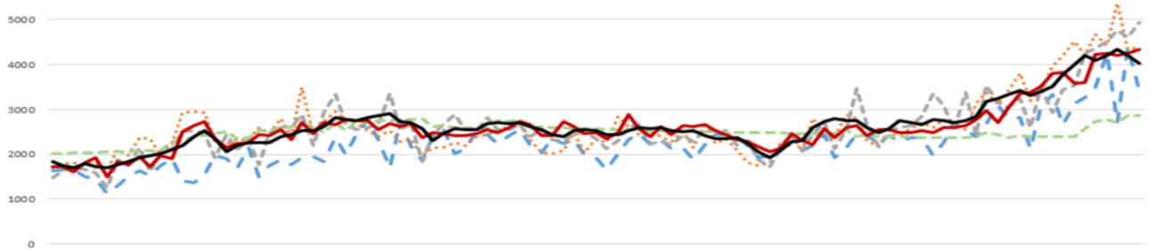
conclusion

Slide 11


